Slide 1
Data Warehousing SS ZG515
PC Reddy
Guest Faculty – WILP, BITS Pilani

Slide 2
Data Warehousing – Lecture 16
Cognos Connection
Oracle settings for DW

Slide 3
Cognos Connection
Overview of How Cognos Works
What is Cognos Connection
Portal Components
Cognos Reporting Tools
Report Creation
Run and Visualize Reports
Pages and Dashboards
Portal Personalization
Distributing and Scheduling Reports
Security

Slide 4
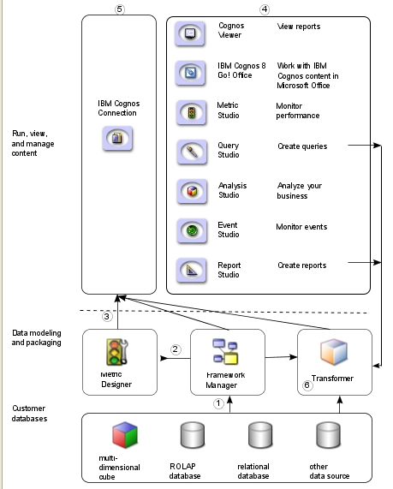
Overview of How Cognos Works
In Framework Manager, the modeler presents the meta data in a manner that business can understand
In Metric Designer, the modeler identifies the data items and calculations that form the targets and actual results for each metric, i.e. KPIs
The modeler then publishes and updates packages to IBM Cognos Connection so that authors can use them to create reports, agents, and scorecards.
Business users and report authors use the published packages to understand their business data.
Users run, view, and manage their content in IBM Cognos Connection.
Transformer is Cognos’s OLAP modeling tool. In Transformer, you can leverage queries in published packages, queries from reports, and personal data sources, such as Microsoft Excel, to create a unique, focused model of your business.

Slide 5
What is Cognos Connection
Cognos Connection is a Web Portal that provides a single access point to all corporate data available in the Cognos 8 Business Intelligence (BI) environment.
This commonly means access to reports created in Report Studio, queries created in Query Studio and analysis created in Analysis Studio
Entire functionality of Cognos reporting tools such as Report Studio, Query Studio, Analysis Studio, Metric Studio and Event Studio is accessible from a single entry point.
Create, Publish and Run Reports
Perform Online Analysis using Cubes & Reports
Add Portlets or Customize Portal by Creating Your Own Pages
Folder, Report, Filter, Bookmark, Web Pages

Slide 6
What is Cognos Connection
Administer Server, Optimize Performance and Set Access Permissions
Report Management
Share Reports to Publically Accessible Locations
Distribute Reports by Email
Print Reports
Schedule Reports

Slide 7
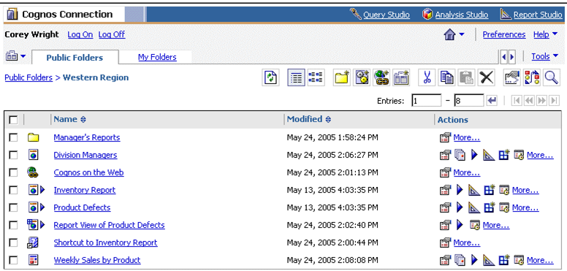
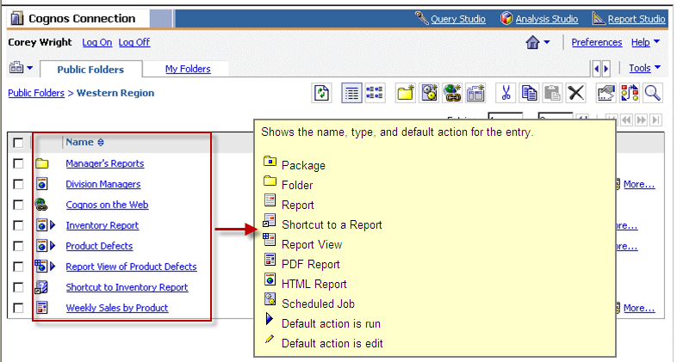
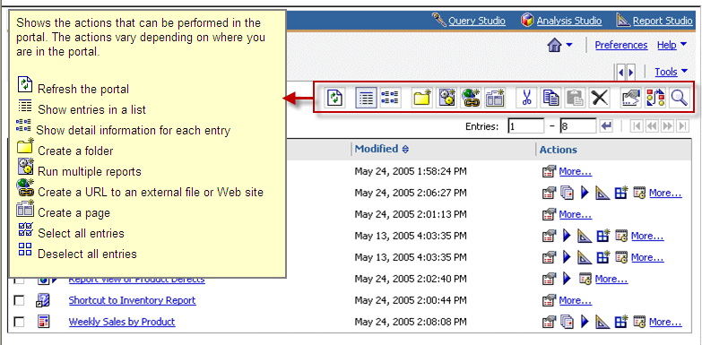
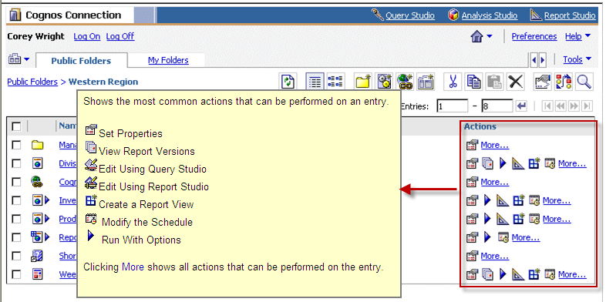
Portal Components

Slide 8
Cognos Reporting Tools
Query Studio
Ad-hoc Simple Custom Reporting Tool for End User
Users can Create Filters, Conditional Formatting, Groups, Chart and Summaries
Report Studio
Allows you to create complex reports with custom prompt pages, drill thru pages, master-detail joins, unions and also allows you to embed java script into the report
PowerPlay Web / Analysis Studio
With Analysis Studio You can you can Perform Multidimensional Analysis and Exploration of Large Data Sources
Example, compare data, such as details to summaries, or actual results to budgeted results

Slide 9
Cognos Reporting Tools
Metric Studio
Metric Studio is a performance tool for monitoring performance measures within an organization. It helps you ensure that your organization's performance is consistent with its targets and goals.
Event Studio
Event Studio is a Web-based product for creating and managing agents that monitor data and perform tasks when the data meets predefined thresholds.

Slide 10
Report Creation
Typical Process
For Query Studio and Report Studio reports, your data modeler creates models from subsets of corporate data.
These models are then published as packages in Cognos Connection.
Each package can point to a different or same data source
Query Studio and Report Studio users can create reports based on the packages and publish them in Cognos Connection.
Steps (Example: Query Studio)
Open Query Studio from within Cognos Connection
Select data from a package
Add data to your report
Perform grouping, formatting, filtering, adding charts
Save Report
Save in Public Folders to make it available to others
Save in My Folder to make it available to yourself

Slide 11
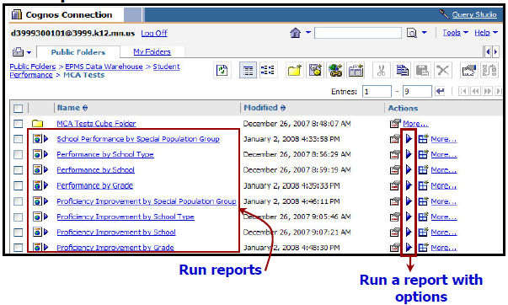
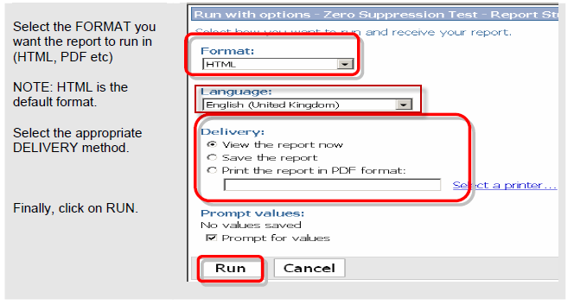
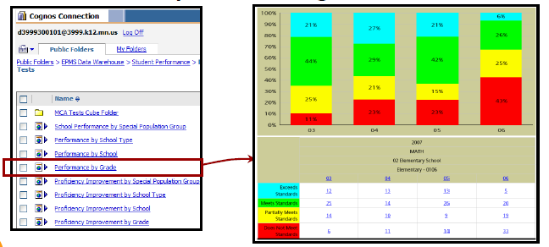
Run and Visualize Reports
Run a report with options to view, print or save in your chosen format

Slide 12
Pages and Dashboards
Cognos Connection pages and dashboards provide quick access to IBM Cognos business intelligence and performance management information, such as reports, metrics, or news items.
The information is relevant to specific users or business objectives, and can be monitored at a glance.
Following table shows the types of content you can add to an IBM Cognos Connection page, and the portlets that provide this content.

Slide 13
Pages and Dashboards
Content | Portlet | Portlet Group
Browse IBM Cognos folders, reports, and other entries | Cognos Navigator | Cognos Content
Search for IBM Cognos reports and other entries | Cognos Search
View and interact with IBM Cognos reports and other entries | Cognos Viewer
View and interact with different types of performance metrics, such as the metrics you want to monitor closely, or the metrics for which you are directly responsible. | Metric List | Cognos Metrics
Add a metric history chart that illustrates the historical performance of the metric | Metric History Chart
Display an impact diagram associated with a metric | Metrics Impact Diagram
Content | Portlet | Portlet Group
Display a custom diagram associated with a scorecard. | Metrics Custom Diagram
View and interact with custom applications created using IBM Cognos 8 Software Development Kit | Cognos Extended Applications | Cognos Extended Applications Portlet
Register and show active links to other Web pages | Bookmarks Viewer | Cognos Utility
Add and view custom images, such as logos | Image Viewer
Insert any other Web page | HTML Viewer
Add and show the content of a Real Simple Syndication (RSS) news feed specified by a URL address | RSS Viewer
Add and view custom text and images | HTML Source
Create and view a dashboard with multiple tabs | Multi-page | Dashboard
Add non-Cognos items to a page | Supported other portlets | Content associated with other portlets

Slide 14
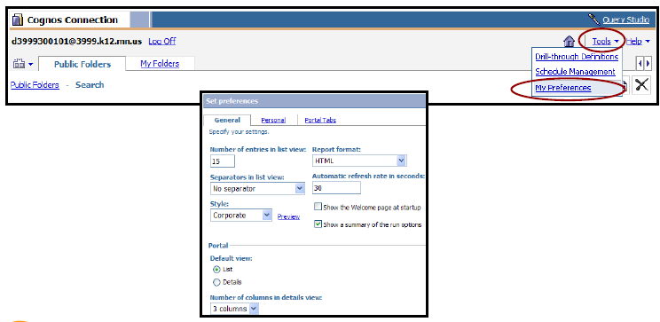
Portal Personalization
You can personalize the way data appear in the portal by changing your preferences
Display can be customized by adding
Shortcuts to items such as queries and reports
Links to files and web sites
Links to your own portal pages
Folders to organize entries neatly
Portal pages contain portlets and give you a very personalized view of your data and the way it is displayed. You can add
Cognos content – select from a menu
A search tool to locate entries in Cognos Connection
Extended applications, for example created by the Software Development Kit
A metrics watchlist
Pages from other web sites

Slide 15
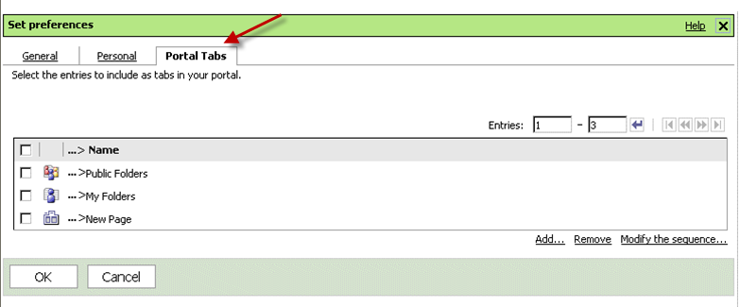
Portal Personalization
Tabs are shortcut to Pages, Public Folders and Private Folders. You can add, remove and reorder tabs

Slide 16
Distributing and Scheduling Reports
Reports can be distributed to other users to share information with them
You can distribute reports by
Saving them in a location that is accessible by other users, such as public folders
Sending them to users via email
Printing
Reports can be scheduled to run at a later date, once or repeatedly
Multiple reports can be setup within a same schedule by creating a job.
A job identifies a collection of reports, report views or queries that are scheduled together and share the same settings

Slide 17
Security
Cognos security model can be easily integrated with your organization’s existing security infrastructure
It is built on top of one or more Authentication Providers, for example
Active Directory Server
LDAP
NTLM
Site Minder
Authentication providers define users, groups and roles used for authentication
Users are granted or denied access to data based on their identity
Permissions are assigned to users, group and roles that allow them to read, write on content objects, such as folders and reports
The content store can be viewed as a hierarchy of data objects. These objects include not only folders and reports, but packages for report creation, directories, and servers.

Slide 18
Security
Administrators distribute reports to users, they can set up folders in which reports and other objects can be stored.
Administrators can secure those folders so that only authorized personnel can view, change, or perform other tasks using the folder contents.

Slide 19
Cognos 8 vs Cognos 10.2
Unified workspace with greater power, intuitive navivation and cleaner look.
Breadth of analytics across historical, real-time and predictive information.
Collaborative BI though built-in collaboration and social networking.
Easy data inclusion by the business.
Faster performance with in-memory processing.
Seamless upgrade and ease of ongoing management.
Expanded deployment options include Cloud.
Major improvements in graphics and visual appeal.
Flexible and robust server administration.

Slide 20
Cognos 8 vs Cognos 10.2
Expanded data sources include:
SAP Netweaver; IBM DB2; SQL server 2005,2008 and 2012; Oracle 10g,11g; Teradata; Siebel; SAP R/3
Dynimic cubes
In-memory OLAP cubes load data directly from relational data warehouses.
Dynamic query-mode leverage 64-bit framework.

Slide 21
SQL Server.
Great for small applications
Offers scalability and reports can be changed easily
Not a lot of built in functionality in the designers
Basically Crystal reports 1.5
Free with a SQL Server DB

Slide 22
Oracle settings and features for DW
Database Block Size (db_block_size parameter)
The block is the fundamental storage unit in Oracle. It is the smallest amount of data that Oracle can read or right at a time
db_block_size specifies the size (in bytes) of these blocks
Can have multiple sizes, but then multiple caches are required
If using buffered I/O, the block size should be the physical block size at the device level
If using direct I/O (no buffers, like raw partitions in Unix, unformatted partitions in Windows or the NTFS file system) you can set the block size to any value
Data Warehouses benefit from a larger block size – more data can be read in a single I/O
A larger value also means that more rows can be inserted into a block before a physical write on the database is needed, speeding up inserts
The higher this setting the more rows there will be in a block in indexes. The indexes will easier to maintain as they will need to be reorganized less frequently
A smaller value can be better for reducing locks in an OLTP system, since less rows will be in each block

Slide 23
Oracle settings and features for DW
PCTFREE
Defined at the table level
The percentage of free space reserved for updated to existing rows in each data block. When an insert results in the amount of free space in the block to be less than this value, the insert is disallowed.
If this value is set to high:
Data blocks won’t hold as many rows as they could, less rows fetched for each I/O operation.
If this value is set to low:
Results in “row migration”, rows can’t get lengthened, so a new block is used, with a pointer to this new block in the old block, decreasing I/O performance.
Fact tables: unlikely that existing rows will need to be modified, set this value to 0.
Dimension tables: updates are possible, a good starting point is 10%. From there, monitor the blocks by querying avg row length and avg space free list blocks from the system table.

Slide 24
Oracle settings and features for DW
optimizer_mode = "all_rows“
Optimize the query to get the very last row as fast as possible. As opposed to “first rows”, which attempts to get the first rows as quickly as possible (OLTP system) .
hash_join_enabled = true
In hash joins, a hash table is created on the join key of the smallest sized table. It then joins the other tables to find the match. Suited for joins involving at least one large data set and requiring many of those rows to be joined -- typically this is between a fact table and a dimension table.
star_transformation_enabled = true
Enables an important optimizer feature for star queries. Oracle processes a star query in two basic steps. The first step retrieves exactly the necessary rows from the fact table (the result set using bitmap indexes). The second step joins this result set to the dimension tables.

Slide 25
Oracle settings and features for DW
NOLOGGING
With this option you can bypass writing to the redo log, which can make operations perform 30-50% faster. The drawback is that you cannot roll-forward to recover, the entire statement must be rerun.
Is done at the object creation time:
create table <new_table> NOLOGGING as select * from <current_table>
Or can be overridden at the tablespace level:
alter tablespace tablespace_name force NOLOGGING;
db_keep_cache_size
Set this value to size the area in memory (SGA) for the KEEP buffer pool. In this pool you can keep database objects in memory (cached). Good candidates are smaller, often used fact tables. SQL to cache the table:
alter table <table_owner>.<table_name> storage (buffer_pool keep);

Slide 26
Materialized Views
A materialized view is an object in the database that contains the results of a query.
Can be used to create summary tables based on aggregation of source tables or create read-only local copies of data that are located on another system (called snapshots).
Can reduce the run time of long running queries by precomputing the results of the query.
Synchronized with their master tables so the results stay current, but they cannot provide real-time results – idea, for use in data warehouses
Another benefit is the ability to then use query rewrite, which transforms a SQL statement that accesses tables or views into a statement that accesses the materialized views we have created. This process is transparent to the user; the system handles the translation of the SQL to use the precomputed MVs, again increasing database performance.
Creating an MV:
create materialized view <materialized view name>
enable query rewrite
as
<select statement>

Slide 27
Parallel Operations
Enable multiple processes to work together simultaniously to process a single SQL operation.
Requires multiple CPUs and that the data be spread out over multiple I/O devices
Overhead is involved with the set up and coordination of the parallel operations, so it’s important to use properly
Oracle optimizer will take degrees of parallelism into account when creating execution paths

Slide 28
Levels of Parallel Execution
Statement level
Using hints or the PARALLEL clause:
SELECT /*+ FULL(<table name>)(PARALLEL(<table name>, 4) */ *
from <table name>
Object Level
Found in the definition of the table, index, or other object:
create table <table_name> <column names and datatypes> PARALLEL (DEGREE 4);
create index <index name> ON <table name> (<column name(s)>) PARALLEL (DEGREE 4);
Instance level
Each instance has a set of default values for DEGREE and INSTANCES. The default DEGREE value is the lesser of the number of CPUs available or the number of disks upon which a table or index is stored. This value will be used when no optimizer hints and when no degree of parallelism has been specified at the table or index level.

Slide 29
Parallel Operations
The preferred method is to use parallelism at the statement level, otherwise, the Oracle optimizer may do full table scans instead of index scans.
Other parallel uses:
Parallel CREATE TABLE . . . AS SELECT
Allows you to reorganize extremely large tables efficiently. Using Export/Import operations may cause more downtime than using this method
Parallel Load
When very large amounts of data must be loaded, the destination tables may be unavailable for an unacceptable amount of time. Loading data in parallel can reduce the amount of downtime. SQL*Loader, an Oracle tool to load data from flat files, supports parallel loading.

Slide 30
Statistics
When SQL is processed, Oracle must decide how to retrieve the data. Using the Cost Based Optimizer (CBO), Oracle determines the optimal (most of the time) execution path by looking at the statistics for the objects in the SQL. Statistics are kept at the table, column, index and system level and are stored in the data dictionary.
Statistics must be updated because database objects are constantly changing. They are gathered using the DBMS_STATS procedures.
Oracle can automatically gather statistics, which is usually scheduled. When objects change rapidly, statistics can also be gathered manually.
The statistics include table sizes, indexes on the tables, the distribution of values in the tables’ columns.
Statistic gathering involves table scans (reading of the entire table) and sorts on tables, which is impractical for large tables. In this case, a sampling level ESTIMATE_PERCENT can be used.

